Slide 1

cc
Team:-
Divyaraj Shreya
Parmeshwar Sanatan
Priya

Slide 2
99
Outline
Problem Statement
Objective
Project Overview
Project Flow
Technology and Tools Used
Terraform
Ansible
Docker Compose
Kubernate Architecture
Conclusion

Slide 3
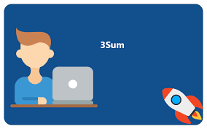
c
Problem Statement
Design and develop tasks required to build CICD pipeline using learned technologies to deploy BookMySlot application to cloud platform as a set of micro services on containerized platform such as docker and Kubernetes. Provision Infrastructure using terraform on aws, and configure same using Ansible.

Slide 4
c
OBJECTIVE
Our objective is to provide best online service for booking the slots for the interview so that Interviewer can book slot as per their schedule.

Slide 5
c
Project Overview
Interviewer
Sign in
Authentication API
Favorite API
Tagteam
Home
signup
MYSQL
Mongo
Db

Slide 6

Project flow
c
Home
Sign In
Signup
Interviewer
Tag Team
Interviewer
Recommendation
Tag Team
Availability
Add Slot
Department
Book Slot
Search Books

Slide 7



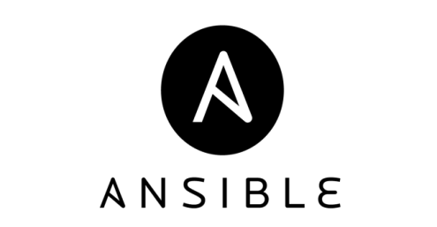

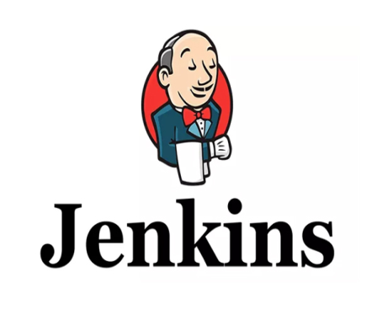


Technologies and Tools Used
c

Slide 8

TERRAFORM
c
  Terraform has all necessary tooling for configuring servers and provisioning infrastructure.
  Terraform is an immutable infrastructure tool.
  It is a flexible tool.

Slide 9
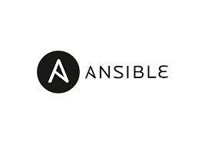
Ansible
c
  Ansible is an open source IT Configuration Management tool.
  It aims to provide large productivity gains to a wide variety of automation challenges.
  This tool is very simple to and use.
  Flexible and Agent Less toll.

Slide 10
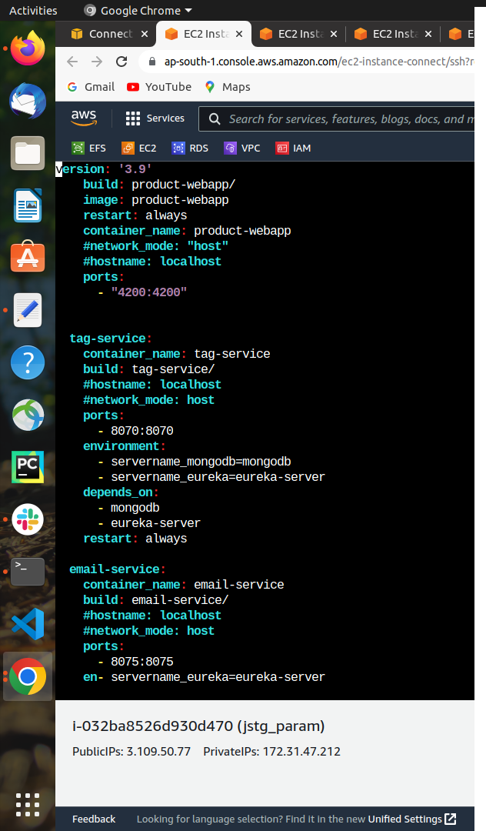
Docker-Compose
c
Compose is a tool for defining and running multi-container Docker applications.
With Compose, you use a YAML file to configure your application's deployment and services.

Slide 11
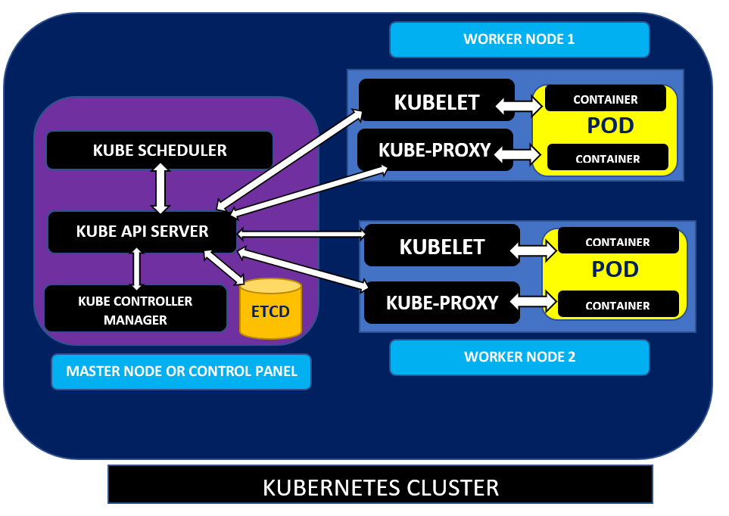
Kubernetes Architecture
c
Advantages of Kubernetes:-
  Kubernete Automates
  Containerized Environments.
  Scaling Up and Down.
  Strong Open Source
  Communities.
  Improve Developer
  Productivity.

Slide 12

Conclusion
c
This Web Application is designed to help the applicant to book interview slot from the Book My Slot.

Slide 13


c

